Slide 1
FYP5: Object Detection, Tracking and Suspicious Activity Recognition for Maritime Surveillance using Thermal Vision

Slide 2
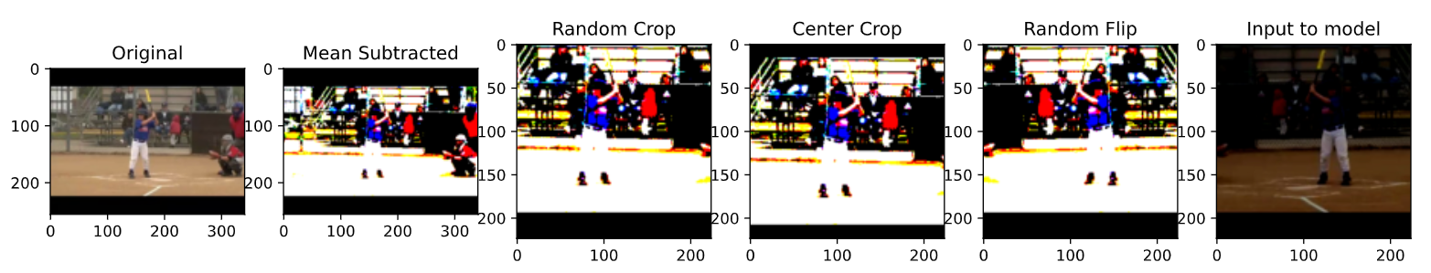
Data Loader
Modifications were done based on publications on Activity Recognition task.
Choosing a random clip per video with constant time gap between them
Applying data augmentation
Mean Subtraction
Random Cropping (Only in training phase)
Random Horizontal Flipping with probability of 0.5 (Only in training phase)
Central Cropping (Only in validation phase)
Action Label – swing_baseball

Slide 3
Training Procedure
Two distinct parameters for the clip size and batch size
Weight update (optimization step) is changed to mimic training with larger batch sizes.
The gradients are updated using the loss for each clip (frames M) and accumulated over a batch
After N number of clips are passed, the weights are updated
We use N = 16 as the batch size and M = 10 as the clip size
The learning rate scheduler:
Initially started with 0.001
At epoch 15, 50 and 80 the lr is reduced by factor of 10
Based on the paper titled "Two-Stream Convolutional Networks for Action Recognition in Videos"

Slide 4

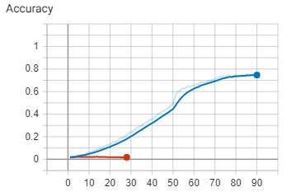
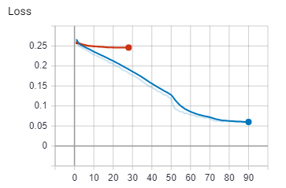
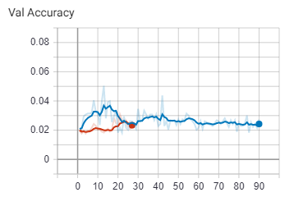
Activity Recognition – Training Results
Trained two versions of our model
STMNet18 - Model overfits on the data set after 15th Epoch
STMNet50 – Model fails to learn, and accuracy is at 2%even after 30th epoch
Training Accuracy and Loss
Validation Accuracy

Slide 5
Plans and Next steps
Using UCF-101 to pre-train the network and finetune on HMDB-51
Parameter tuning for the current training procedure – to check whether the results can be improved.
Start working on the temporal localization of the actions
Start working on a Survey Paper (targeting ICIP) for Temporal Localization, Activity Classification and Spatio-Temporal Localization (Given that we don’t obtain adequate results from any of the above-mentioned steps.)

